Slide 1
HE WILL REIGN FOR EVER AND EVER
Revelation 8:6-11:19

Slide 2
15 The seventh angel sounded his trumpet, and there were loud voices in heaven, which said: "The kingdom of the world has become the kingdom of our Lord and of his Christ, and he will reign for ever and ever."

Slide 3
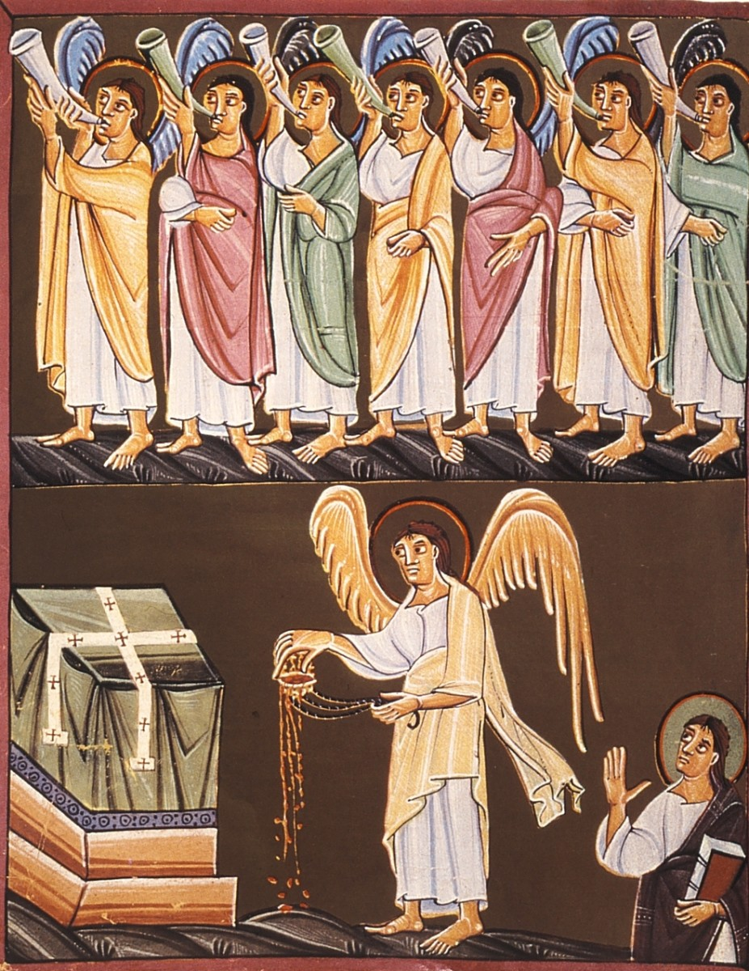
8:2 And I saw the seven angels who stand before God, and to them were given seven trumpets. 3 Another angel, who had a golden censer, came and stood at the altar. He was given much incense to offer, with the prayers of all the saints, on the golden altar before the throne.

Slide 4
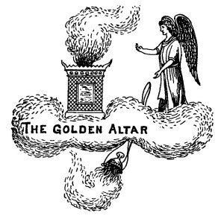
8:2 And I saw the seven angels who stand before God, and to them were given seven trumpets. 3 Another angel, who had a golden censer, came and stood at the altar. He was given much incense to offer, with the prayers of all the saints, on the golden altar before the throne.

Slide 5
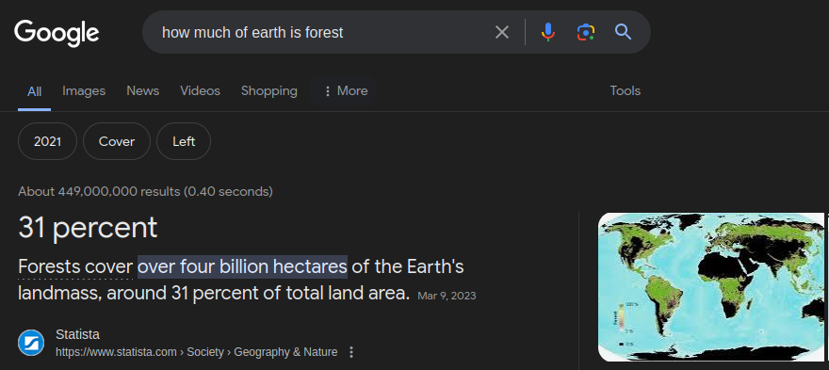
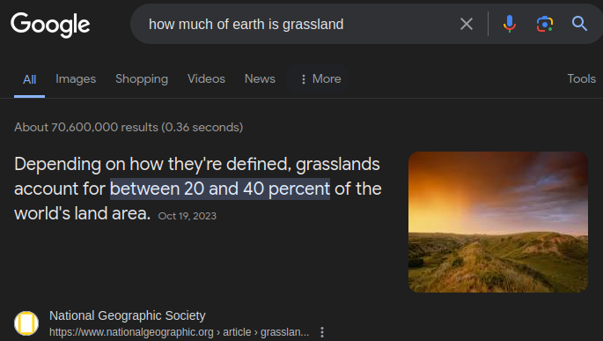
7 The first angel sounded his trumpet, and there came hail and fire mixed with blood, and it was hurled down upon the earth. A third of the earth was burned up, a third of the trees were burned up, and all the green grass was burned up.
⅓ of forests = 10% of earth surface
20% of earth surface could be considered grassland.
Together they are conceivably around 1/3rd of the earth.

Slide 6
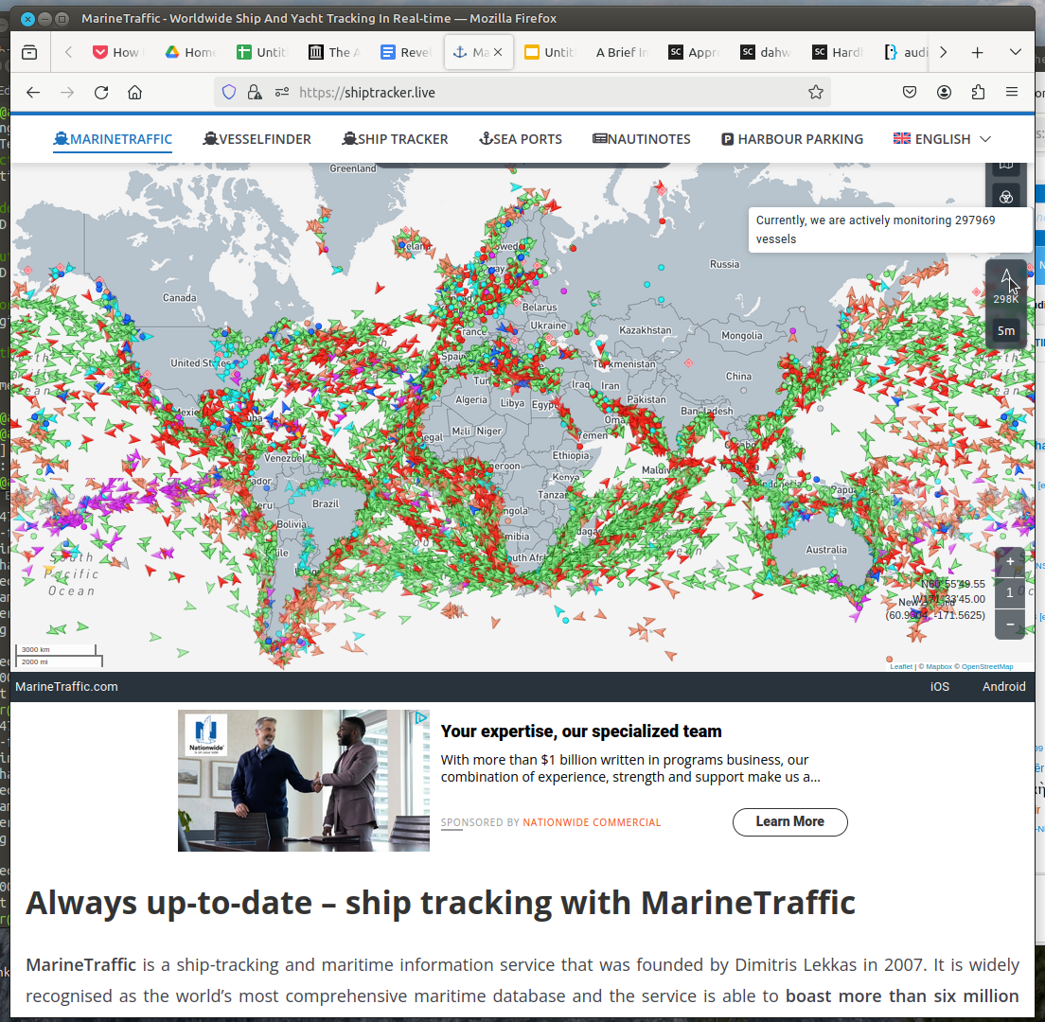
8 The second angel sounded his trumpet, and something like a huge mountain, all ablaze, was thrown into the sea. A third of the sea turned into blood, 9 a third of the living creatures in the sea died, and a third of the ships were destroyed.
Here is a mapping site that claims to track almost 300,000 ships.
What could happen in the sea to destroy ⅓ of them?

Slide 7
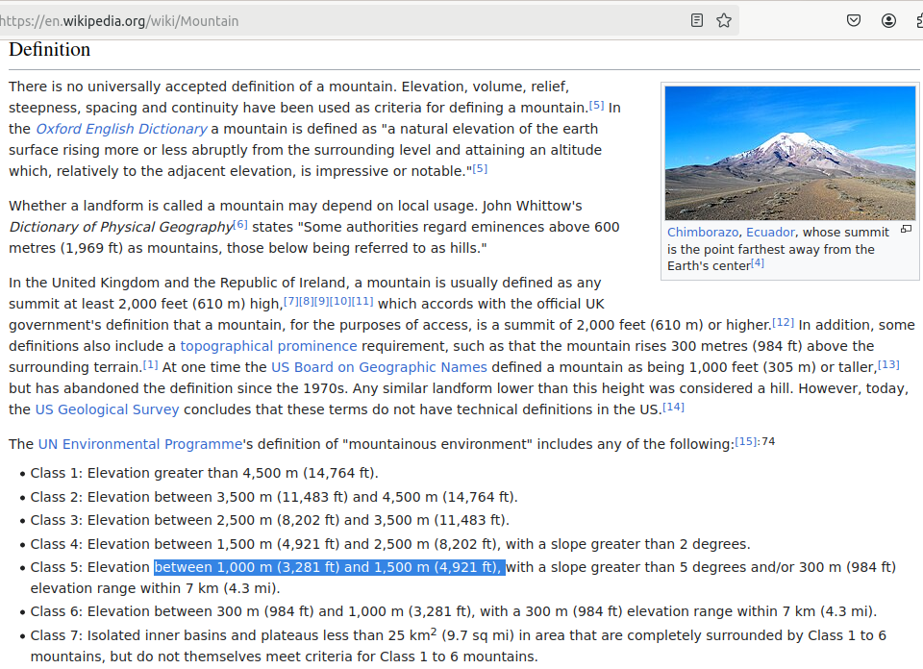
8 The second angel sounded his trumpet, and something like a huge mountain, all ablaze, was thrown into the sea. A third of the sea turned into blood, 9 a third of the living creatures in the sea died, and a third of the ships were destroyed.
According to Wikipedia, a small mountain is between 1000 and 1500m high.

Slide 8
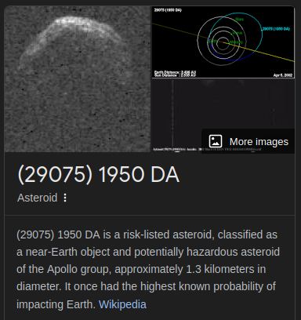
8 The second angel sounded his trumpet, and something like a huge mountain, all ablaze, was thrown into the sea. A third of the sea turned into blood, 9 a third of the living creatures in the sea died, and a third of the ships were destroyed.
There is an asteroid out in space that some thought could hit earth in a couple thousand years. It might be about 1300m wide.

Slide 9
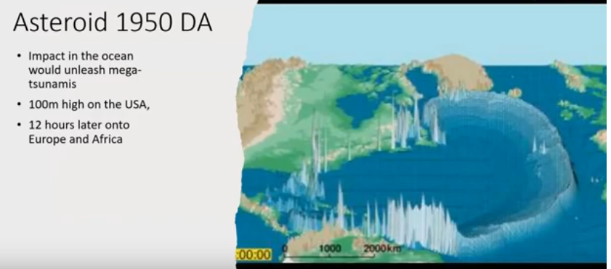
8 The second angel sounded his trumpet, and something like a huge mountain, all ablaze, was thrown into the sea. A third of the sea turned into blood, 9 a third of the living creatures in the sea died, and a third of the ships were destroyed.
A small mountain size object crashing into the sea could send 100m high tsunami waves across north and south american coasts.

Slide 10
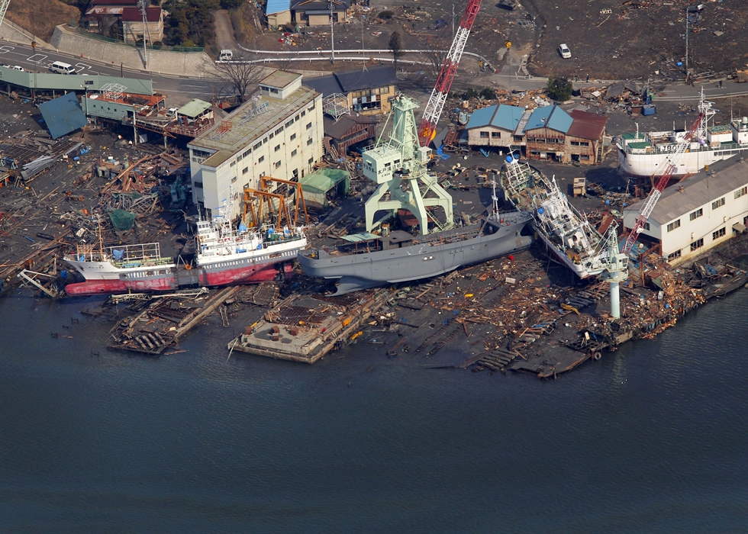
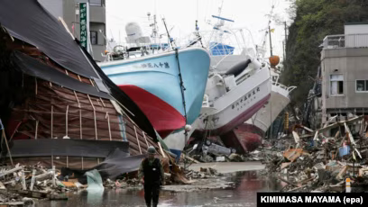
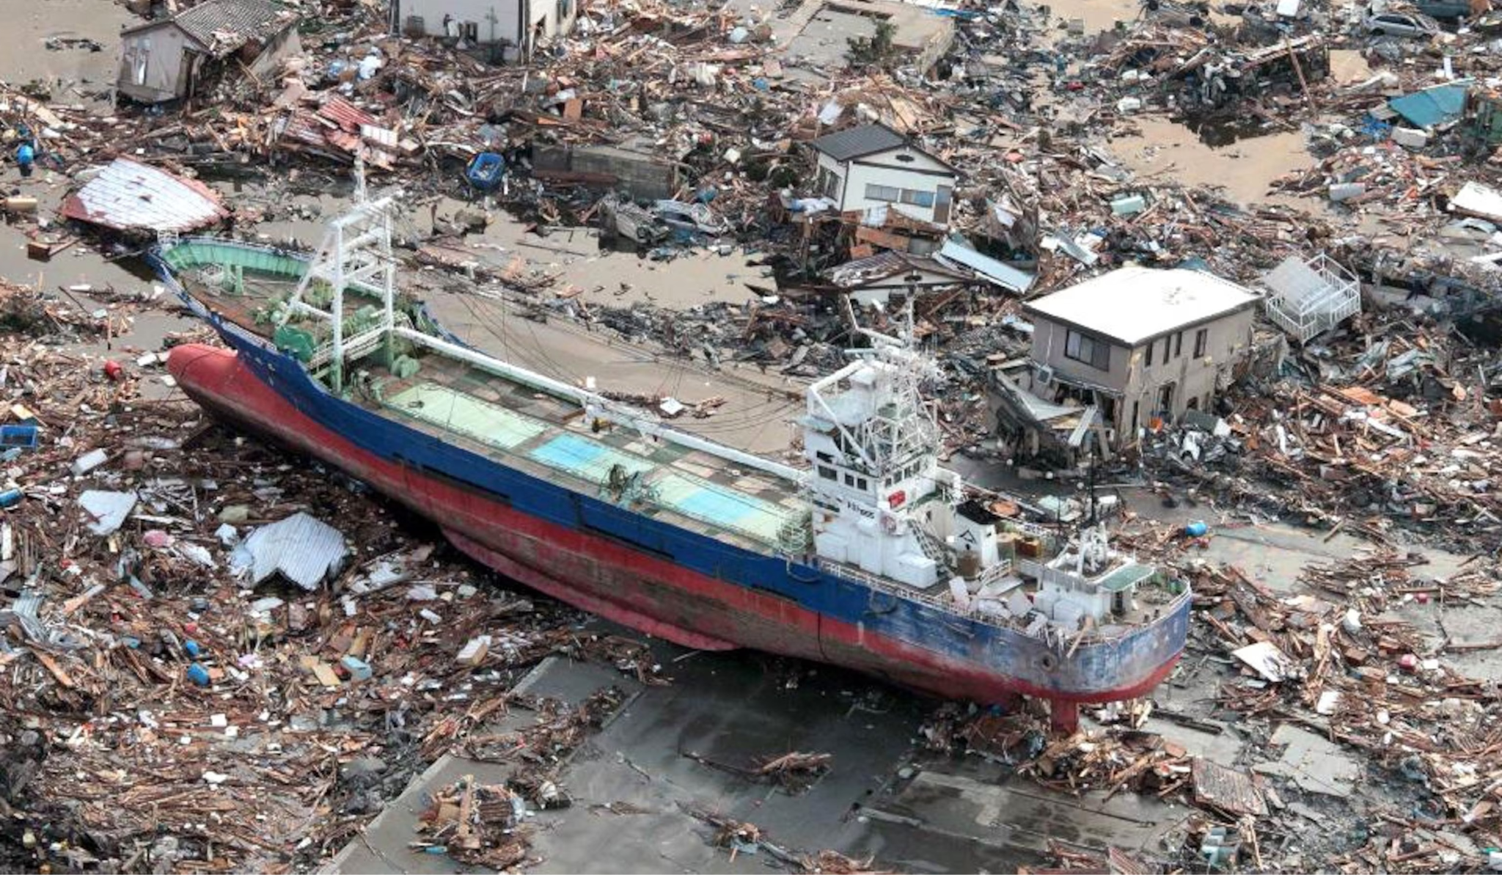
8 The second angel sounded his trumpet, and something like a huge mountain, all ablaze, was thrown into the sea. A third of the sea turned into blood, 9 a third of the living creatures in the sea died, and a third of the ships were destroyed.
2011 Tsunami waves some 40m high. Even 14m at shore could flood over 20m high significantly inland wrecking many ships and properties.
FYI N.B. NJ Elevation: 62′

Slide 11
8 The second angel sounded his trumpet, and something like a huge mountain, all ablaze, was thrown into the sea. A third of the sea turned into blood, 9 a third of the living creatures in the sea died, and a third of the ships were destroyed.

Slide 12
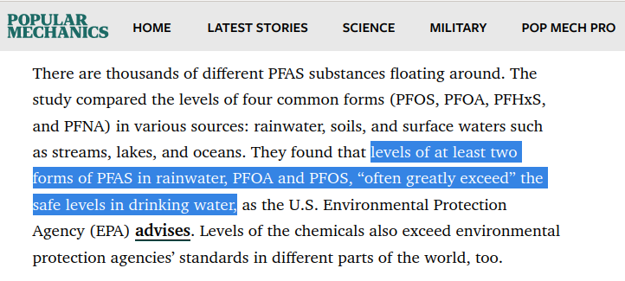
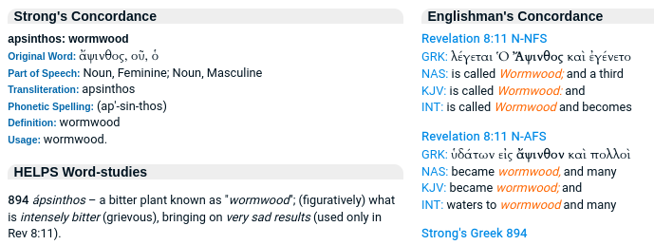
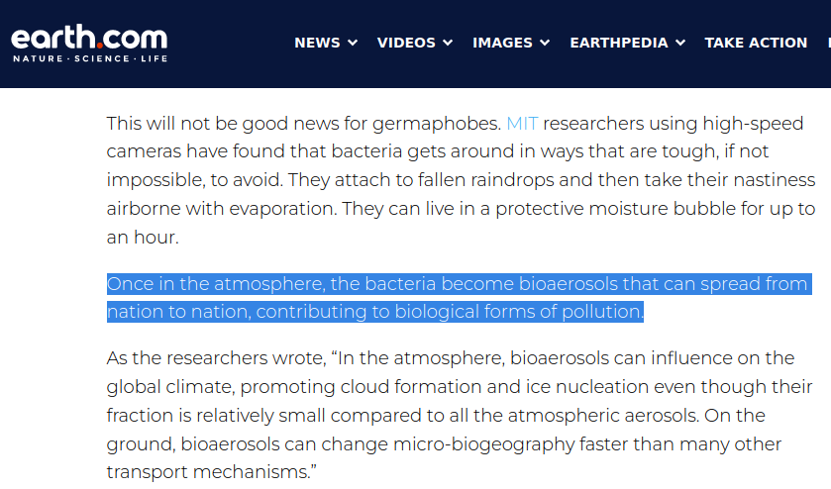
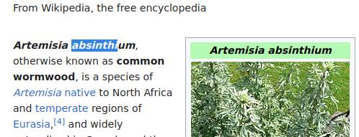
10 The third angel sounded his trumpet, and a great star, blazing like a torch, fell from the sky on a third of the rivers and on the springs of water-- 11 the name of the star is Wormwood. A third of the waters turned bitter, and many people died from the waters that had become bitter.

Slide 13
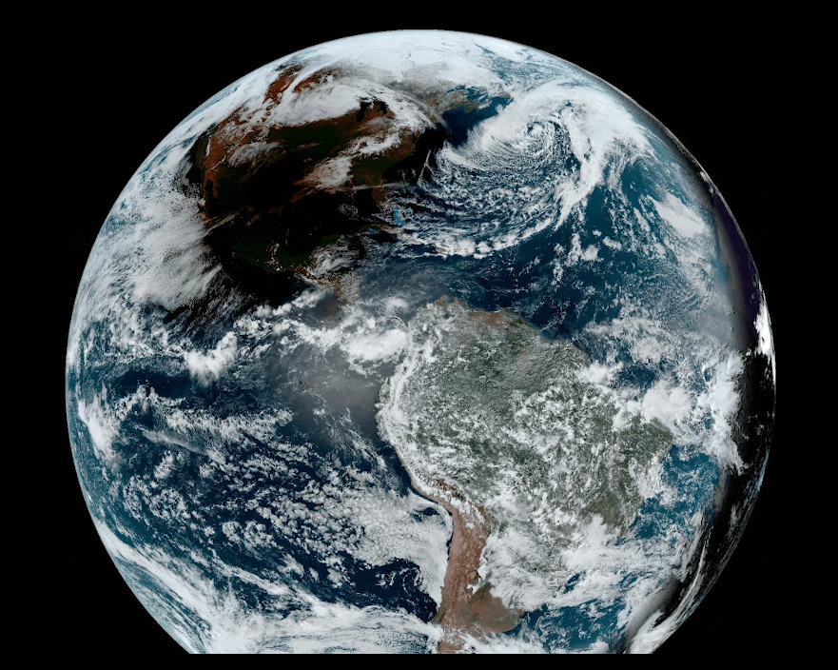
12 The fourth angel sounded his trumpet, and a third of the sun was struck, a third of the moon, and a third of the stars, so that a third of them turned dark. A third of the day was without light, and also a third of the night. 13 As I watched, I heard an eagle that was flying in midair call out in a loud voice: "Woe! Woe! Woe to the inhabitants of the earth, because of the trumpet blasts about to be sounded by the other three angels!"

Slide 14
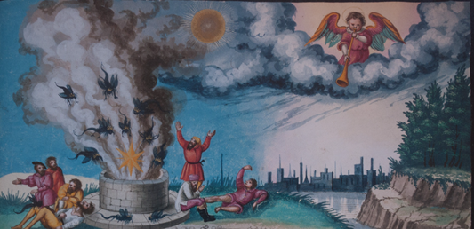
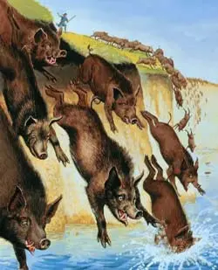
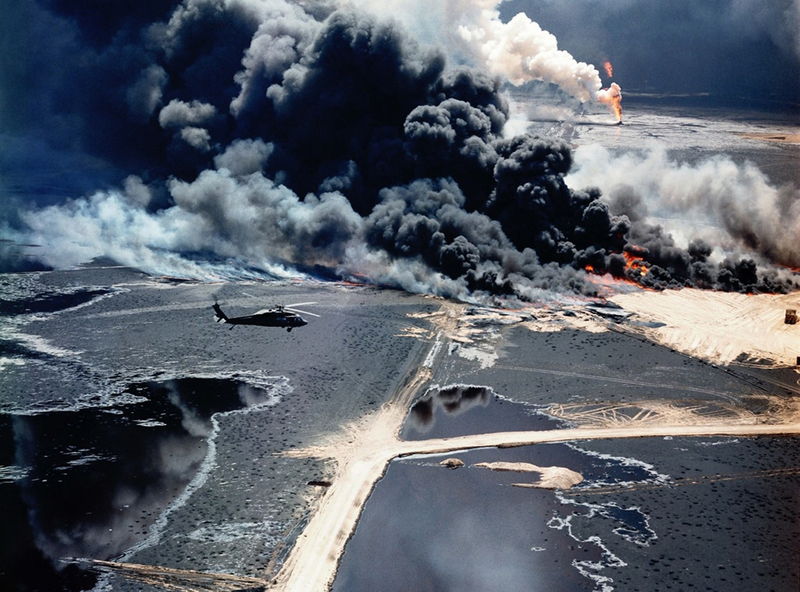
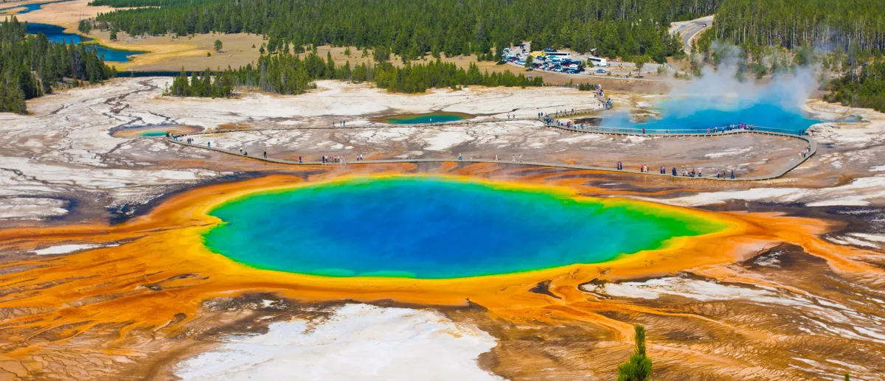
9:1 The fifth angel sounded his trumpet, and I saw a star that had fallen from the sky to the earth. The star was given the key to the shaft of the Abyss. 2 When he opened the Abyss, smoke rose from it like the smoke from a gigantic furnace. The sun and sky were darkened by the smoke from the Abyss. 3 And out of the smoke locusts came down upon the earth and were given power like that of scorpions of the earth.

Slide 15
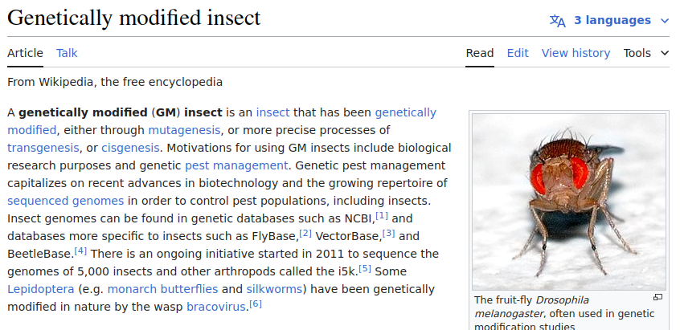
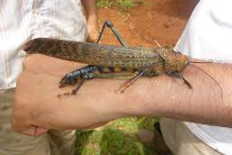
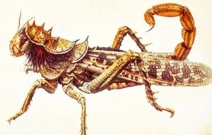
9:1 The fifth angel sounded his trumpet, and I saw a star that had fallen from the sky to the earth. The star was given the key to the shaft of the Abyss. 2 When he opened the Abyss, smoke rose from it like the smoke from a gigantic furnace. The sun and sky were darkened by the smoke from the Abyss. 3 And out of the smoke locusts came down upon the earth and were given power like that of scorpions of the earth.

Slide 16
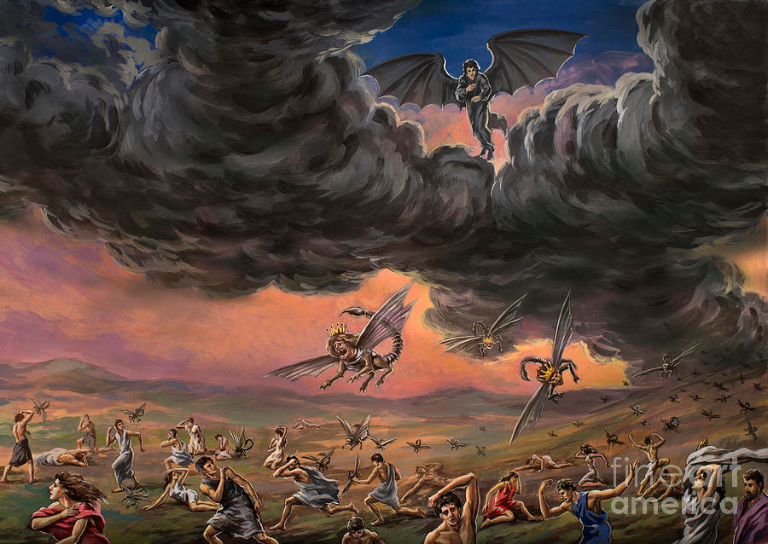
9:1 The fifth angel sounded his trumpet, and I saw a star that had fallen from the sky to the earth. The star was given the key to the shaft of the Abyss. 2 When he opened the Abyss, smoke rose from it like the smoke from a gigantic furnace. The sun and sky were darkened by the smoke from the Abyss. 3 And out of the smoke locusts came down upon the earth and were given power like that of scorpions of the earth.

Slide 17
13 The sixth angel sounded his trumpet, and I heard a voice coming from the horns of the golden altar that is before God. 14 It said to the sixth angel who had the trumpet, "Release the four angels who are bound at the great river Euphrates." 15 And the four angels who had been kept ready for this very hour and day and month and year were released to kill a third of mankind. ... 16 The number of the mounted troops was two hundred million. I heard their number.

Slide 18
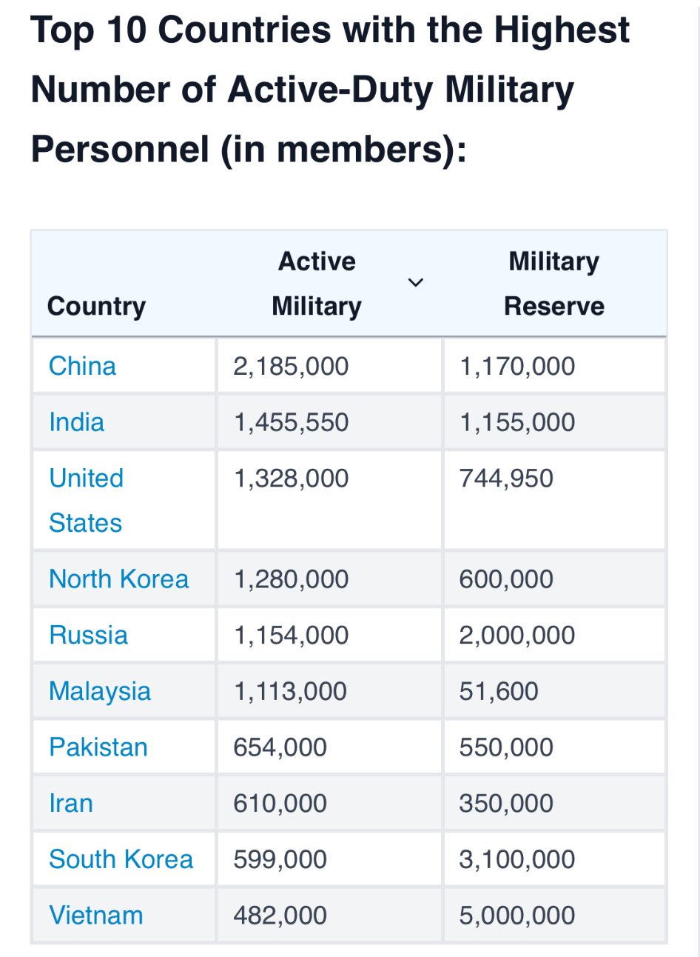
13 The sixth angel sounded his trumpet, and I heard a voice coming from the horns of the golden altar that is before God. 14 It said to the sixth angel who had the trumpet, "Release the four angels who are bound at the great river Euphrates." 15 And the four angels who had been kept ready for this very hour and day and month and year were released to kill a third of mankind. ... 16 The number of the mounted troops was two hundred million. I heard their number.

Slide 19
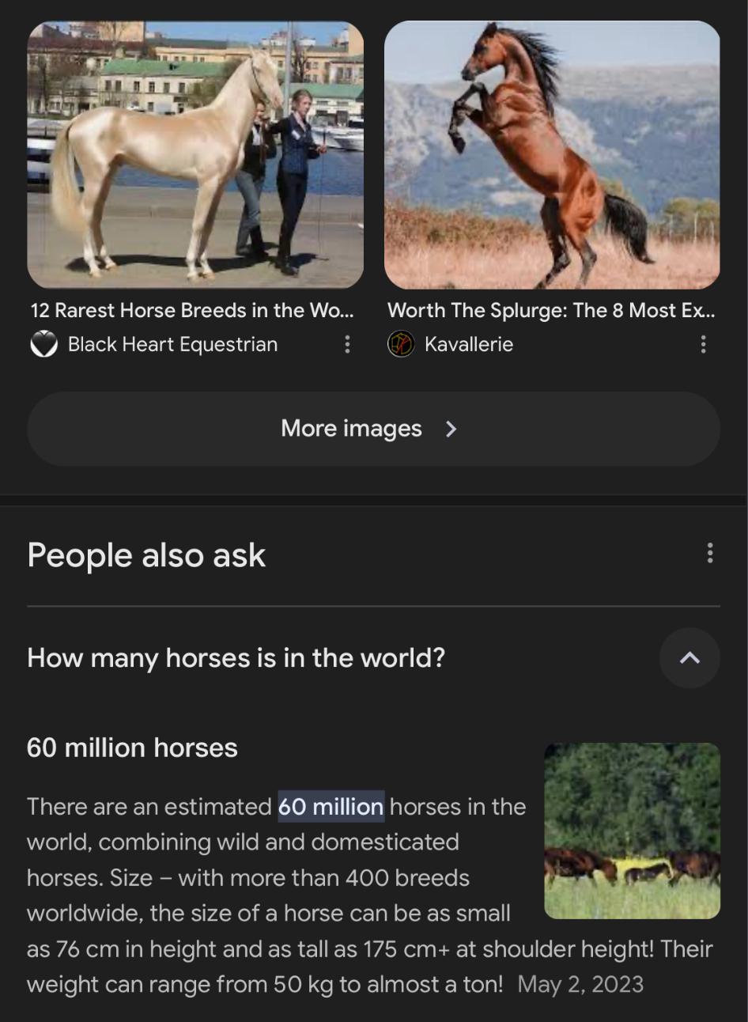
13 The sixth angel sounded his trumpet, and I heard a voice coming from the horns of the golden altar that is before God. 14 It said to the sixth angel who had the trumpet, "Release the four angels who are bound at the great river Euphrates." 15 And the four angels who had been kept ready for this very hour and day and month and year were released to kill a third of mankind. ... 16 The number of the mounted troops was two hundred million. I heard their number.

Slide 20
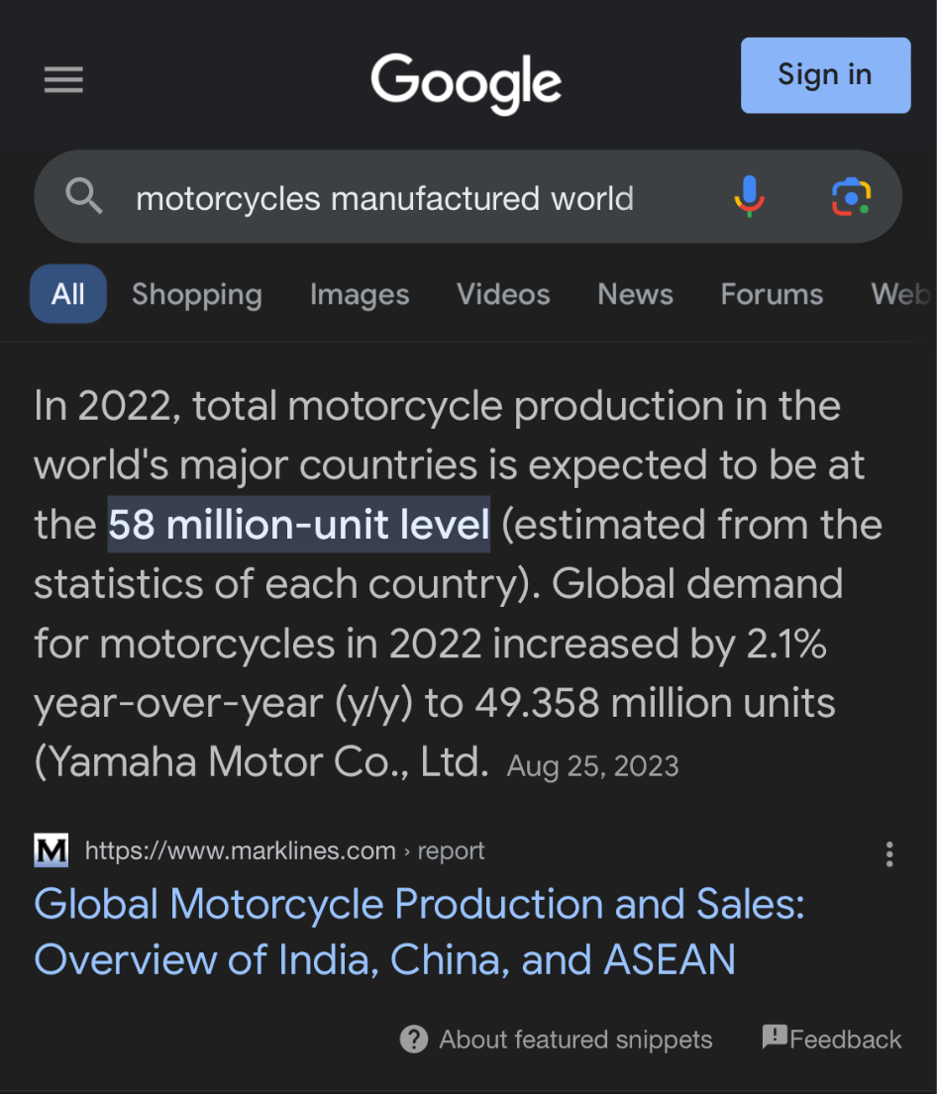
17 The horses and riders I saw in my vision looked like this: Their breastplates were fiery red, dark blue, and yellow as sulfur. The heads of the horses resembled the heads of lions, and out of their mouths came fire, smoke and sulfur. 18 A third of mankind was killed by the three plagues of fire, smoke and sulfur that came out of their mouths. 19 The power of the horses was in their mouths and in their tails; for their tails were like snakes, having heads with which they inflict injury.

Slide 21
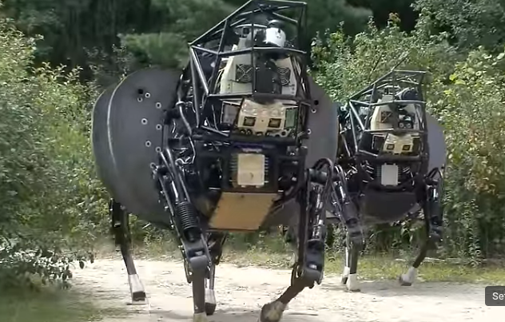
17 The horses and riders I saw in my vision looked like this: Their breastplates were fiery red, dark blue, and yellow as sulfur. The heads of the horses resembled the heads of lions, and out of their mouths came fire, smoke and sulfur. 18 A third of mankind was killed by the three plagues of fire, smoke and sulfur that came out of their mouths. 19 The power of the horses was in their mouths and in their tails; for their tails were like snakes, having heads with which they inflict injury.
BigDog's tryouts https://www.popsci.com/article/technology/darpa-spends-10-million-make-bigdog-stronger-and-stealthier/
Tail that might inflict injuries
https://www.popsci.com/technology/article/2013-03/watch-our-favorite-four-legged-military-robot-hurl-cinder-block

Slide 22
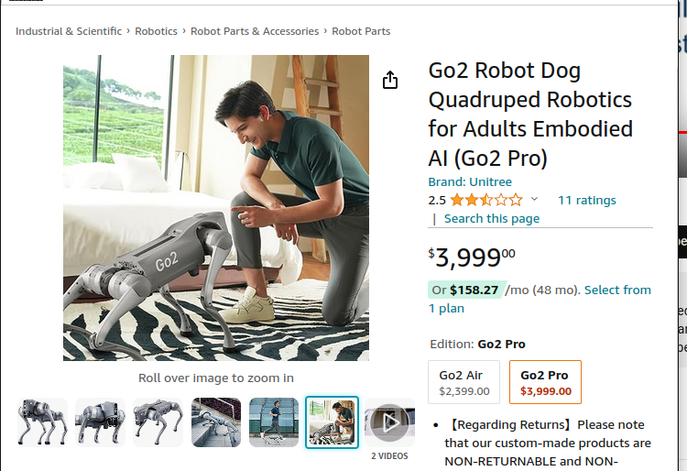
17 The horses and riders I saw in my vision looked like this: Their breastplates were fiery red, dark blue, and yellow as sulfur. The heads of the horses resembled the heads of lions, and out of their mouths came fire, smoke and sulfur. 18 A third of mankind was killed by the three plagues of fire, smoke and sulfur that came out of their mouths. 19 The power of the horses was in their mouths and in their tails; for their tails were like snakes, having heads with which they inflict injury.

Slide 23
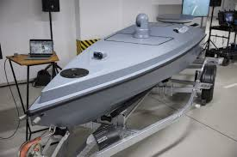
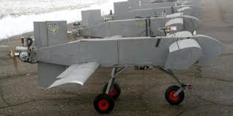
17 The horses and riders I saw in my vision looked like this: Their breastplates were fiery red, dark blue, and yellow as sulfur. The heads of the horses resembled the heads of lions, and out of their mouths came fire, smoke and sulfur. 18 A third of mankind was killed by the three plagues of fire, smoke and sulfur that came out of their mouths. 19 The power of the horses was in their mouths and in their tails; for their tails were like snakes, having heads with which they inflict injury.

Slide 24
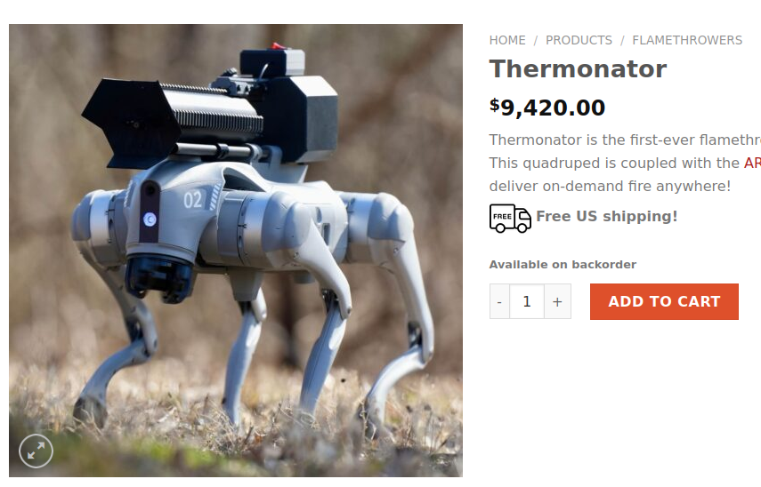
17 The horses and riders I saw in my vision looked like this: Their breastplates were fiery red, dark blue, and yellow as sulfur. The heads of the horses resembled the heads of lions, and out of their mouths came fire, smoke and sulfur. 18 A third of mankind was killed by the three plagues of fire, smoke and sulfur that came out of their mouths. 19 The power of the horses was in their mouths and in their tails; for their tails were like snakes, having heads with which they inflict injury.
Destructive weaponized version
https://www.youtube.com/watch?v=rj9JSkSpRlM&t=50s

Slide 25
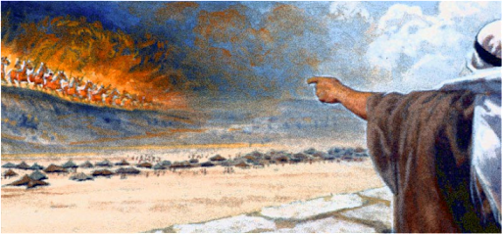
17 The horses and riders I saw in my vision looked like this: Their breastplates were fiery red, dark blue, and yellow as sulfur. The heads of the horses resembled the heads of lions, and out of their mouths came fire, smoke and sulfur. 18 A third of mankind was killed by the three plagues of fire, smoke and sulfur that came out of their mouths. 19 The power of the horses was in their mouths and in their tails; for their tails were like snakes, having heads with which they inflict injury.

Slide 26
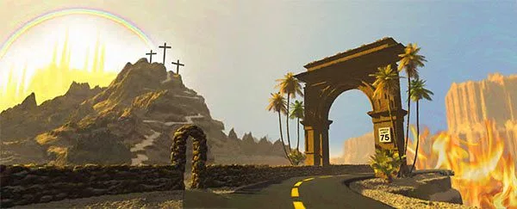
20 The rest of mankind that were not killed by these plagues still did not repent of the work of their hands; they did not stop worshiping demons, and idols of gold, silver, bronze, stone and wood--idols that cannot see or hear or walk. 21 Nor did they repent of their murders, their magic arts, their sexual immorality or their thefts.

Slide 27
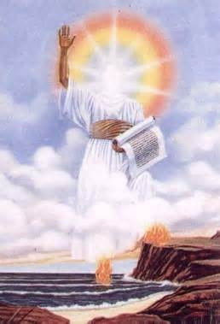
10:1 Then I saw another mighty angel coming down from heaven. He was robed in a cloud, with a rainbow above his head; his face was like the sun, and his legs were like fiery pillars. 2 He was holding a little scroll, which lay open in his hand. He planted his right foot on the sea and his left foot on the land, 3 and he gave a loud shout like the roar of a lion. When he shouted, the voices of the seven thunders spoke.

Slide 28
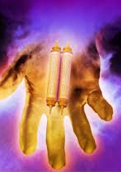
8 Then the voice that I had heard from heaven spoke to me once more: "Go, take the scroll that lies open in the hand of the angel who is standing on the sea and on the land." 9 So I went to the angel and asked him to give me the little scroll. He said to me, "Take it and eat it. It will turn your stomach sour, but in your mouth it will be as sweet as honey."

Slide 29
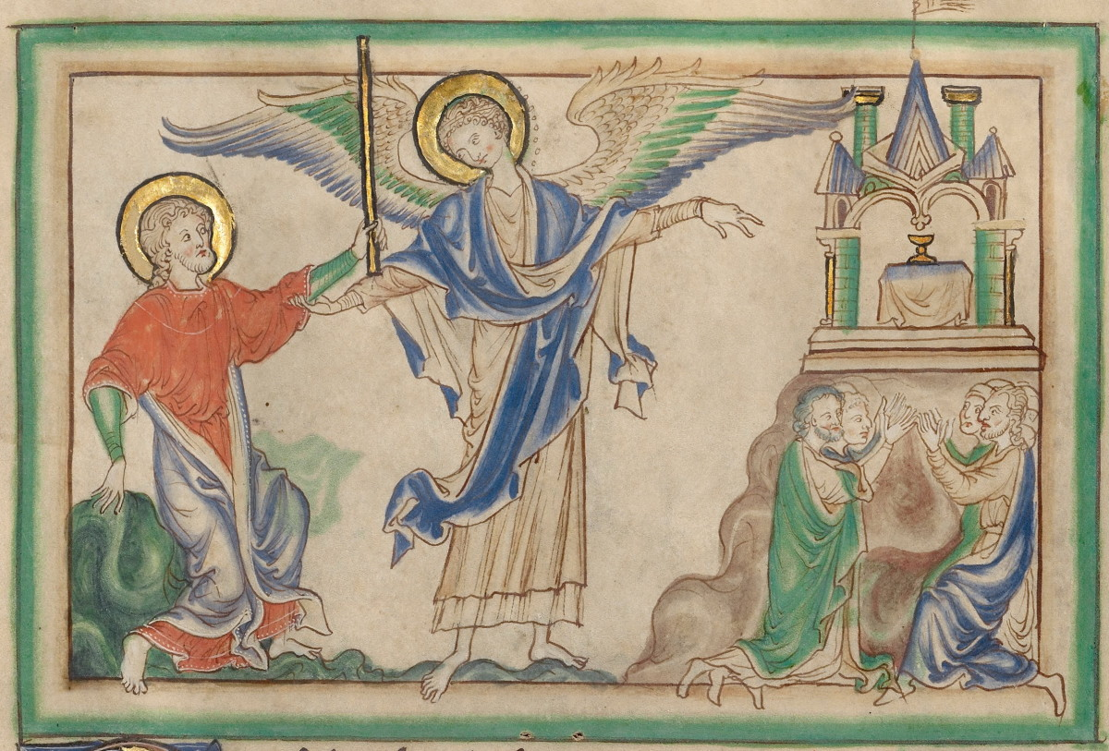
11:1 I was given a reed like a measuring rod and was told, "Go and measure the temple of God and the altar, and count the worshipers there. 2 But exclude the outer court; do not measure it, because it has been given to the Gentiles. They will trample on the holy city for 42 months.

Slide 30
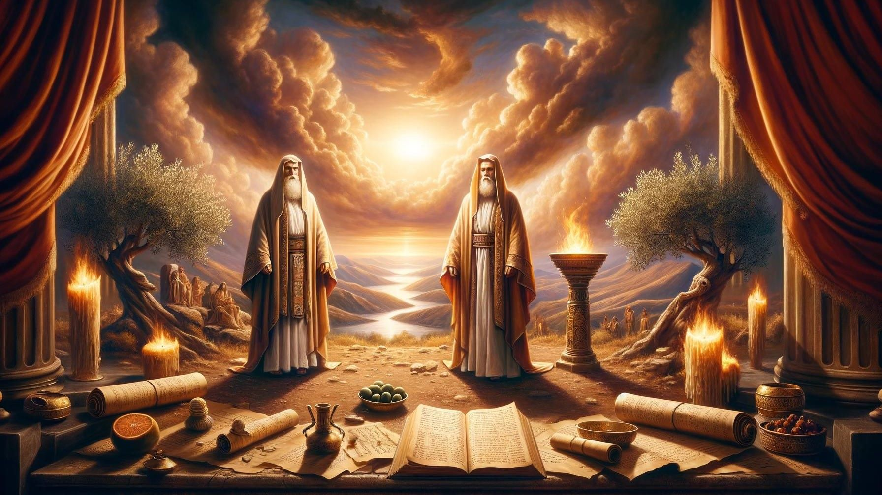
3 And I will give power to my two witnesses, and they will prophesy for 1,260 days, clothed in sackcloth." 4 These are the two olive trees and the two lampstands that stand before the Lord of the earth.

Slide 31
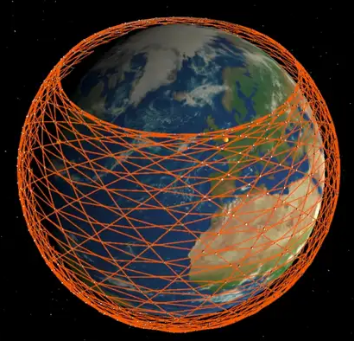
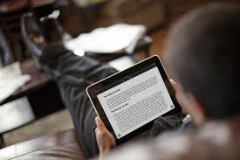
3 And I will give power to my two witnesses, and they will prophesy for 1,260 days, clothed in sackcloth." 4 These are the two olive trees and the two lampstands that stand before the Lord of the earth.

Slide 32
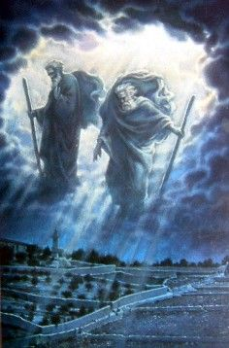
3 And I will give power to my two witnesses, and they will prophesy for 1,260 days, clothed in sackcloth." 4 These are the two olive trees and the two lampstands that stand before the Lord of the earth.

Slide 33
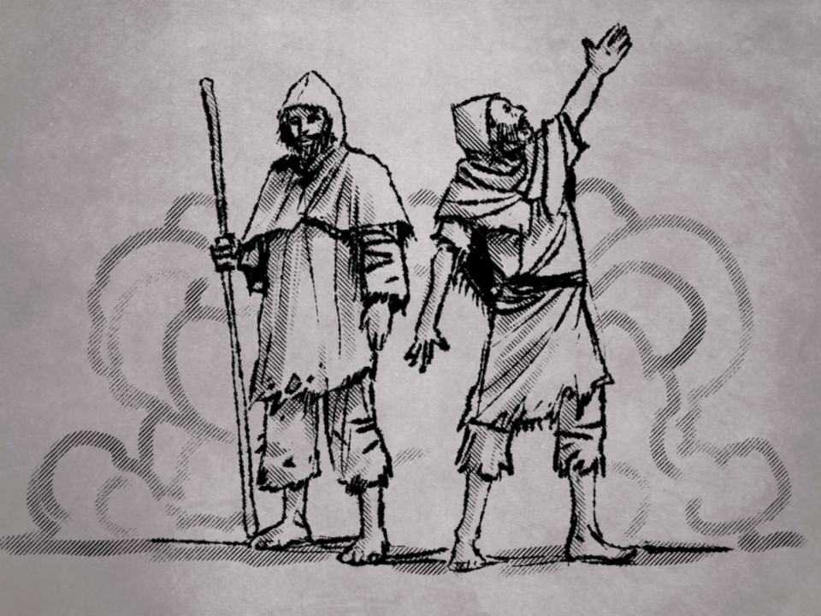
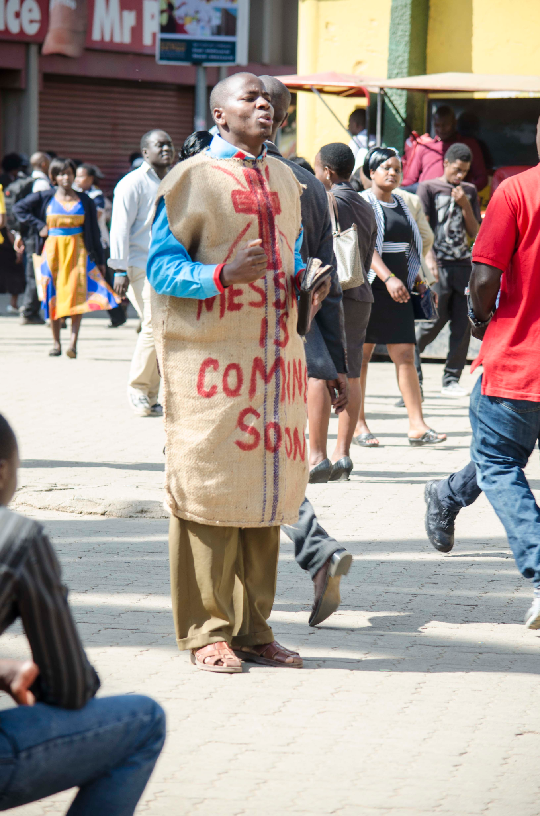
3 And I will give power to my two witnesses, and they will prophesy for 1,260 days, clothed in sackcloth." 4 These are the two olive trees and the two lampstands that stand before the Lord of the earth.

Slide 34
7 Now when they have finished their testimony, the beast that comes up from the Abyss will attack them, and overpower and kill them. 8 Their bodies will lie in the street of the great city, which is figuratively called Sodom and Egypt, where also their Lord was crucified. 9 For three and a half days men from every people, tribe, language and nation will gaze on their bodies and refuse them burial. 10 The inhabitants of the earth will gloat over them and will celebrate by sending each other gifts, because these two prophets had tormented those who live on the earth. 11 But after the three and a half days a breath of life from God entered them, and they stood on their feet, and terror struck those who saw them. 12 Then they heard a loud voice from heaven saying to them, "Come up here." And they went up to heaven in a cloud, while their enemies looked on.

Slide 35
13 At that very hour there was a severe earthquake and a tenth of the city collapsed. Seven thousand people were killed in the earthquake, and the survivors were terrified and gave glory to the God of heaven.
14 The second woe has passed; the third woe is coming soon.

Slide 36
15 The seventh angel sounded his trumpet, and there were loud voices in heaven, which said: "The kingdom of the world has become the kingdom of our Lord and of his Christ, and he will reign for ever and ever."
16 And the twenty-four elders, who were seated on their thrones before God, fell on their faces and worshiped God, 17 saying: "We give thanks to you, Lord God Almighty, the One who is and who was, because you have taken your great power and have begun to reign. 18 The nations were angry; and your wrath has come. The time has come for judging the dead, and for rewarding your servants the prophets and your saints and those who reverence your name, both small and great-- and for destroying those who destroy the earth."
19 Then God's temple in heaven was opened, and within his temple was seen the ark of his covenant. And there came flashes of lightning, rumblings, peals of thunder, an earthquake and a great hailstorm.

